Slide 1
Red and Processed Meat Consumption and Risk for All-Cause Mortality and Cardiometabolic Outcomes
Cristian Ordoñez
CVRR Rotation
Jeff Luckring MS, RD, LD

Slide 2
Background
Current dietary guidelines recommend reducing intake of red and processed meat (1)
USDA Nutrition Evidence Library (NEL) states SF are positively associated with increased serum LDL-cholesterol, increased risk of CVD, increased insulin resistance, and increased risk of T2D.
AHA Presidential Advisory: Individuals w/ CVD or high cholesterol SF recommendations </= 5-6% total kcals
Everyone else limit SF to <10% of total kcal

Slide 3
Study of Focus
Published 10/01/19 by Annals of Internal Medicine
Bradley Johnston, PhD, Dalhousie University in Canada, and NutriRECS colleagues
Systematic review of cohort studies
Included cohort studies with at least 1000 adults that compared effects of consuming different amounts of red meat or processed meat
Notes:
Annals of internal medicine is very well known and widely cited medical journal with large impact factor
NutriRECS (nutritional recommendations and accessible Evidence summaries composed of systematic reviews): independent group with clinical, nutritional, and public health content expertise
Outcomes of interest: all-cause mortality, cardiovascular mortality, CVD, MI, T2D, anemia, quality of life, satisfaction with diet
31 cohort studies (2.2 million participants) eligible for inclusion in dose-response meta-analyses

Slide 4
Methods
4 systematic reviews of research literature looked at relationship between meat intake and heart disease, cancer, stroke, T2D
5th meta-analysis looked at peoples preferences/personal values about eating meat
Assessed certainty of Evidence using GRADE approach for each outcome
Notes:
GRADE: grading of recommendations assessment, development and evaluation

Slide 5
GRADE
Grading of Recommendations, Assessment, Development, and Evaluations
Framework for making clinical practice recommendations generally for drug implementation
Reduced certainty: risk of bias, inconsistency, indirectness, imprecision, publication bias
Increased certainty: large effect, if suspected bias works against observed direction of effect, dose-response gradient
Notes:
Statistical analysis is done in systematic review to determine risk factor with exposure and outcome, then GRADE is used to assess quality of evidence based on these guidelines. Observational studies start at very low certainty, while RCT (gold standard for cause and effect) starts at high certainty. RCT’s in nutrition for finding long-term effects of a food close to impossible to implement, so the observational studies included here began at a very low certainty.

Slide 6
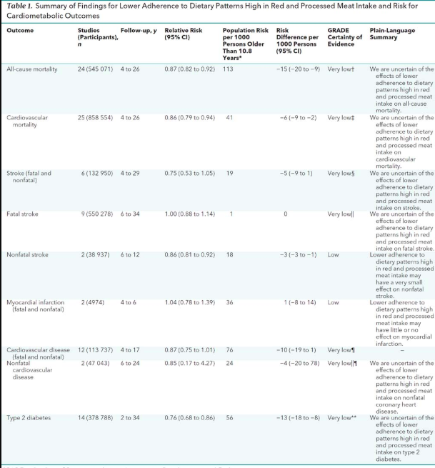
Results
Low to very low certainty evidence that reducing red meat intake by 3 servings is associated with very small reduction in risk for desired outcomes
Low to very low certainty that reduction in processed meat is associated with very small reduced risk of desired outcomes
Notes:
Lecture slide

Slide 7
Controversy
“…the panel believed that for the majority of individuals, the desirable effects (a potential lowered risk for cancer and cardiometabolic outcomes) associated with reducing meat consumption probably do not outweigh the undesirable effects (impact on quality of life, burden of modifying culture and personal meal preparation and eating habits.)”
Committee for Responsible Medicine filed claim with Federal Trade Commission to correct these false statements
More than enough evidence to support current dietary recommendations
Missing data: exclusion of key studies such as PREDIMED study, the DASH study, the Lifestyle Heart Trial study
Notes:
Nonprofit with 12,000 doctors
PREDIMED study: established ability of a Mediterranean diet that replaced red meat with more healthful foods to reduce CV risk. Showed vegetarian diets had largest reduction in all cause mortality and CV mortality
DASH (dietary approaches to stop hypertension) study: showed that diet reduces blood pressure, shifted diet away from red meat towards other choices
Lifestyle Heart Trial: showed that low-fat vegetarian diet as part of overall healthy lifestyle could revere progression of even severe coronary heart disease

Slide 8
Controversy (cont.)
Inclusion of irrelevant data to make guidelines
Using GRADE for nutrition studies - nutrition studies are generally observational- Not RCT’s therefore GRADE downplays results of observational studies
Dr. Johnson- possible conflict of interest?
Excluded studies looking at environmental impact of meat industry
Notes:
GRADE is generally used to evaluate drugs- not Nutritional studies. Better used to assess RCTs not observational studies, so should not be used to assess the long term effects of red meat consumption seen in these cohort studies
Published controversial paper few years ago suggesting eating sugar is fine, funding was received by Coca-Cola, Nestlè, Mcdonalds, Pepsi
Claims no outside funding was received for this analysis- critics wonder how they were able to afford to do their work?

Slide 9
What does this mean for Nutrition professionals?
As nutrition professionals, we have a lot of explaining to do
Until higher quality evidence published, continue limiting intake of red meat/processed meat
What studies DO show is that regions of the world that follow typical Mediterranean diet have lower overall rate of chronic diseases
Eat diet high in plant based foods, nuts, seeds, legumes, fruits, vegetables, and relatively low in meat
Notes:
Front line of defense for bad nutrition information and helping provide patients with high quality evidence based research
Try to eat lean red meat no more than 2-3 times a week and avoid processed meat as much as possible

Slide 10
References
U.S. Department of Agriculture, U.S. Department of Health and Human Services. Dietary Guidelines for Americans 2015–2020. New York: Skyhorse; 2015.
EAL. https://www.andeal.org/topic.cfm?menu=5285&cat=5583. Accessed October 16, 2019.
EAL. https://www.andeal.org/topic.cfm?cat=1447&evidence_summary_id=251264&highlight=saturated%20fat&home=1. Accessed October 16, 2019.
Zeraatkar D, Han MA, Guyatt GH, et al. Red and Processed Meat Consumption and Risk for All-Cause Mortality and Cardiometabolic Outcomes: A Systematic Review and Meta-analysis of Cohort Studies. Ann Intern Med. October 2019. doi:10.7326/M19-0655
Appel LJ, Moore TJ, Obarzanek E, et al. A Clinical Trial of the Effects of Dietary Patterns on Blood Pressure. New England Journal of Medicine. 1997;336(16):1117-1124. doi:10.1056/NEJM199704173361601
Primary Prevention of Cardiovascular Disease with a Mediterranean Diet | NEJM. https://www.nejm.org/doi/full/10.1056/NEJMoa1200303. Accessed October 17, 2019.

